Slide 1
Causal Discovery Algorithms

Slide 2
Agenda
Discovery vs inference
Causal discovery algorithms
PC
GES
LiNGAM
NOTEARS
Code and examples

Slide 3
Discovery vs Inference

Slide 4
Graph

Slide 5
Directed graph

Slide 6
Directed graph
A directed graph (V,E) is:
a set V (vertices, or nodes)
and a set E⊂V×V (edges).

Slide 7
Directed graph

Slide 8
Directed graph

Slide 9
Directed acyclic graph (DAG)

Slide 10
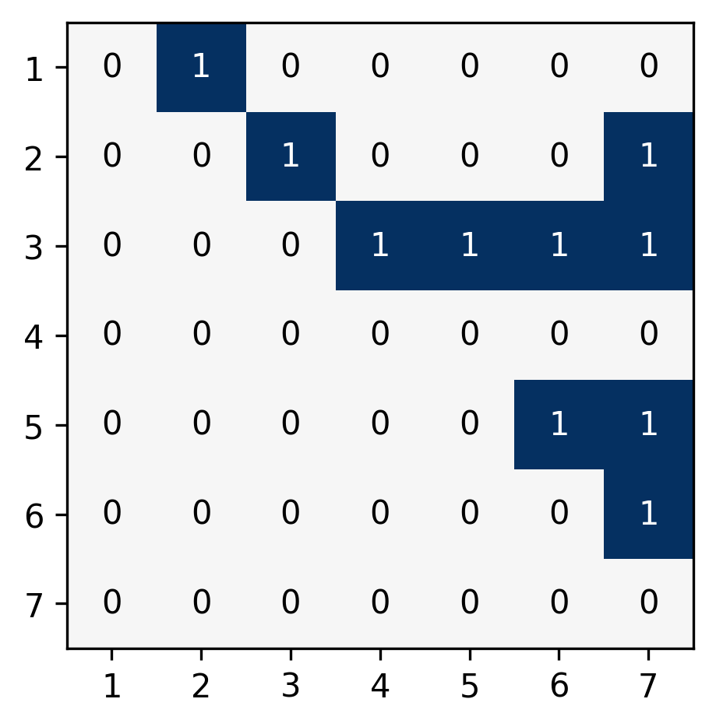
Adjacency Matrix
3
2
4
1
5
7
6

Slide 11
Topological order
3
2
4
1
5
7
6

Slide 12
Data Generation Process
X₁ = f₁(ε₁) X₂ = f₂(X₁,ε₂) X₃ = f₃(ε₃) X₄ = f₄(X₂,X₃,ε₄) X₅ = f₅(X₄,ε₅)

Slide 13
Structural Causal
Model
X₁ = f₁(ε₁) X₂ = f₂(X₁,ε₂) X₃ = f₃(ε₃) X₄ = f₄(X₂,X₃,ε₄) X₅ = f₅(X₄,ε₅)

Slide 14
Causal Graph
Structural Causal
Model
X₁
X₁ = f₁(ε₁) X₂ = f₂(X₁,ε₂) X₃ = f₃(ε₃) X₄ = f₄(X₂,X₃,ε₄) X₅ = f₅(X₄,ε₅)
X₂
X₃
X₄
X₅

Slide 15
Causal Discovery
Causal
Inference
X₁
X₁ = f₁(ε₁) X₂ = f₂(X₁,ε₂) X₃ = f₃(ε₃) X₄ = f₄(X₂,X₃,ε₄) X₅ = f₅(X₄,ε₅)
X₂
X₃
X₄
X₅

Slide 16

Intervention
X₁
X₁ = f₁(ε₁) X₂ = f₂(X₁,ε₂) X₃ = f₃(ε₃) X₄ = x₄ X₅ = f₅(X₄,ε₅)
X₂
X₃
X₄
X₅

Slide 17
Intervention
X₁
X₁ = f₁(ε₁) X₂ = f₂(X₁,ε₂) X₃ = f₃(ε₃) X₄ = x₄ X₅ = f₅(X₄,ε₅)
X₂
X₃
X₄
X₅

Slide 18
Discovery vs Inference
Causal discovery: finding the causal graph from data
Causal inference: using the structural causal model to answer “what if” questions

Slide 19
Causality ladder
Association: E[Y|T=t]
Intervention: E[Y|do(T=t)]
Counterfactuals: E[Y|do(T=t),T=t’]
Severity
Treatment
Outcome

Slide 20
Causality ladder
Association: E[Y|T=t]
Intervention: E[Y|do(T=t)]
Counterfactuals: E[Y|do(T=t),T=t’]
Severity
Treatment
Outcome

Slide 21
Causality ladder
Association: E[Y|T=t]
Intervention: E[Y|do(T=t)]
Counterfactuals: E[Y|do(T=t),T=t’]
Treatment
Outcome
Severity
Treatment
Outcome

Slide 22
Causality ladder
Association: E[Y|T=t]
Intervention: E[Y|do(T=t)]
Counterfactuals: E[Y|do(T=t),T=t’]
Treatment
Outcome
Severity
Treatment
Outcome

Slide 23
Causality Ladder
Association
If the patient received an aggressive treatment, it means his condition was already severe: the expected outcome is bad.
Intervention
If we were to give all patients an aggressive treatment, the outcome would be good on average.
Counterfactural
This specific patient received the non-aggressive treatment; this means his condition was mild; if we had given him the aggressive treatment, the outcome would have been good.

Slide 24
Simpson’s paradox
Introduction to Causal Inference (B. Neal, 2020)

Slide 25
Fundamental Problem
We often want to compute the average treatment effect,
ATE = E[Y|do(T=1)] - E[Y|do(T=0)],
but, for each subject, we either have T=1 or T=0, so we do not know the other.

Slide 26
Do Calculus
Do Calculus is a set of rules to compute, when possible, the effect interventions would have from observational data alone, given the causal graph.
Introduction to Causal Inference (B. Neal, 2020, theorem 6.2, page 55)

Slide 27
Confounder
Z
X
Y

Slide 28
Collider
X
Y
Z

Slide 29
Mediator
X
Z
Y

Slide 30
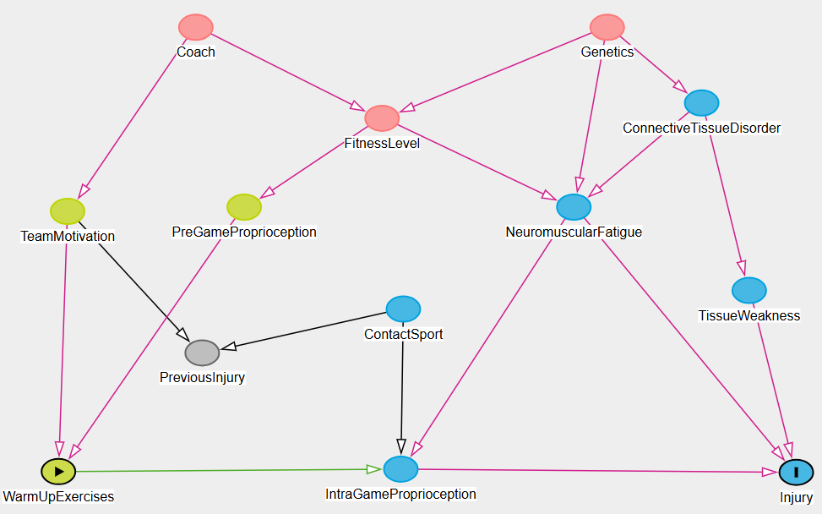
Real-world causal graphs
https://www.dagitty.net/dags.html

Slide 31
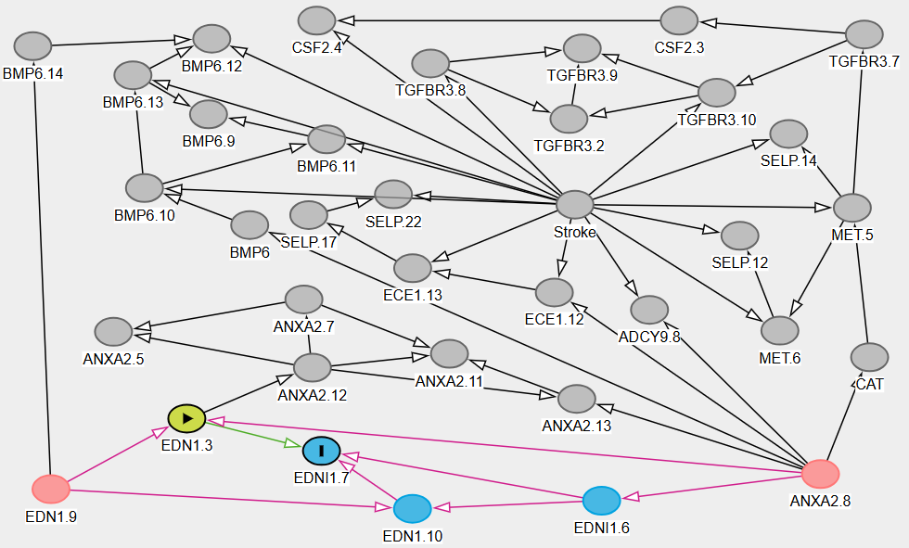
Real-world causal graphs
https://www.dagitty.net/dags.html

Slide 32
Open and closed paths
open
open
open
closed
closed
closed
closed
open
open
Not in the conditioning set
In the conditioning set

Slide 33
Causal inference
To assess the strength of the causal relation X→Y:
List all the (undirected) paths from X to Y
All the non-causal paths should be blocked; if not, condition on one or more nodes to block them.
All the causal paths should be open; if not, adjust the conditioning set to unblock them.

Slide 34
Causal Discovery Algorithms

Slide 35
Causal Discovery Algorithms
PC: Conditional independence tests
GES: Scores
LiNGAM: Independent component analysis
NOTEARS: Optimization

Slide 36
PC Algorithm

Slide 37
Conditional Independence
X⟂̸Y
X
Y
X
Y
X⟂Y
X⟂̸Y|Z
Z
Z
X⟂̸Y
X⟂Y|Z
X
Y

Slide 38
Ground truth DAG (unknown)
A
Start with a complete (undirected) graph
Remove the edge X—Y if X⊥Y|Z for some (possibly empty) set of nodes Z
For all X—Z—Y, if X⟂Y and X⟂̸Y|Z, we have a collider X→Z←Y
Propagate the orientation, assuming we have found all the colliders
B
E
C
D

Slide 39
A
Start with a complete (undirected) graph
Remove the edge X—Y if X⊥Y|Z for some (possibly empty) set of nodes Z
For all X—Z—Y, if X⟂Y and X⟂̸Y|Z, we have a collider X→Z←Y
Propagate the orientation, assuming we have found all the colliders
B
E
C
D

Slide 40
A
Start with a complete (undirected) graph
Remove the edge X—Y if X⊥Y|Z for some (possibly empty) set of nodes Z
For all X—Z—Y, if X⟂Y and X⟂̸Y|Z, we have a collider X→Z←Y
Propagate the orientation, assuming we have found all the colliders
B
E
C
D

Slide 41
B⟂̸C
C⟂̸E
A
Start with a complete (undirected) graph
Remove the edge X—Y if X⊥Y|Z for some (possibly empty) set of nodes Z
For all X—Z—Y, if X⟂Y and X⟂̸Y|Z, we have a collider X→Z←Y
Propagate the orientation, assuming we have found all the colliders
B
E
C
D

Slide 42
A
Start with a complete (undirected) graph
Remove the edge X—Y if X⊥Y|Z for some (possibly empty) set of nodes Z
For all X—Z—Y, if X⟂Y and X⟂̸Y|Z, we have a collider X→Z←Y
Propagate the orientation, assuming we have found all the colliders
B
E
C
D

Slide 43
E⟂D|A
B⟂D|A
C⟂D|A
A
Start with a complete (undirected) graph
Remove the edge X—Y if X⊥Y|Z for some (possibly empty) set of nodes Z
For all X—Z—Y, if X⟂Y and X⟂̸Y|Z, we have a collider X→Z←Y
Propagate the orientation, assuming we have found all the colliders
B
E
C
D

Slide 44
A
Start with a complete (undirected) graph
Remove the edge X—Y if X⊥Y|Z for some (possibly empty) set of nodes Z
For all X—Z—Y, if X⟂Y and X⟂̸Y|Z, we have a collider X→Z←Y
Propagate the orientation, assuming we have found all the colliders
B
E
C
D

Slide 45
B⟂C
B⟂̸C|A
A
Start with a complete (undirected) graph
Remove the edge X—Y if X⊥Y|Z for some (possibly empty) set of nodes Z
For all X—Z—Y, if X⟂Y and X⟂̸Y|Z, we have a collider X→Z←Y
Propagate the orientation, assuming we have found all the colliders
B
E
C
D

Slide 46
A
Start with a complete (undirected) graph
Remove the edge X—Y if X⊥Y|Z for some (possibly empty) set of nodes Z
For all X—Z—Y, if X⟂Y and X⟂̸Y|Z, we have a collider X→Z←Y
Propagate the orientation, assuming we have found all the colliders
B
E
C
D

Slide 47
Since C→A,
if D→A,
we would have C⟂̸D|A
A
Start with a complete (undirected) graph
Remove the edge X—Y if X⊥Y|Z for some (possibly empty) set of nodes Z
For all X—Z—Y, if X⟂Y and X⟂̸Y|Z, we have a collider X→Z←Y
Propagate the orientation, assuming we have found all the colliders
B
E
C
D

Slide 48
A
Start with a complete (undirected) graph
Remove the edge X—Y if X⊥Y|Z for some (possibly empty) set of nodes Z
For all X—Z—Y, if X⟂Y and X⟂̸Y|Z, we have a collider X→Z←Y
Propagate the orientation, assuming we have found all the colliders
B
E
C
D

Slide 49
PC algorithm
Ground truth
Complete graph
Independence tests
Conditional independence tests
Colliders
Non-collider
Undirected edges
Final result

Slide 50
Markov equivalence class
Conditional independence relations cannot separate all DAGs: they can only recover the Markov equivalence class (MEC) of the causal model.

Slide 51
Independence tests
Partial correlation (Fisher Z)
Kernel-based tests
χ² test (for discrete data)

Slide 52
Unobserved confounder
X₁
X₂
X₁⟂̸X₄| X₃
X₃
X₄

Slide 53
Unobserved confounder
X₁
X₂
X₁⟂X₄| X₃
X₃
X₄

Slide 54
GES

Slide 55
GES (Greedy Equivalent Search)
Start with an empty graph
Greedily add the edges whose addition increases the score the most
Greedily remove the edges whose removal increase the score the most
Score: BIC, when forecasting a variable from its parents

Slide 56
LiNGAM

Slide 57
LinGAM
The structural causal model (SCM) X₁ = μ₁ + ε₁ X₂ = μ₂ + a₂₁ X₁ + ε₂ ⋮ Xₖ = μₖ + aₖ₁ + ⋯ + aₖₖ₋₁Xₖ₋₁ + εₖ can be written X=μ+AX+ε, or ε=(I-A)X-μ, with ∀i≠j εᵢ⊥εⱼ
If the εᵢ’s are non-Gaussian, ICA (independent component analysis) can recover the linear transformation (I-A)X by looking for the directions in which the data is the least Gaussian.

Slide 58
NOTEARS

Slide 59
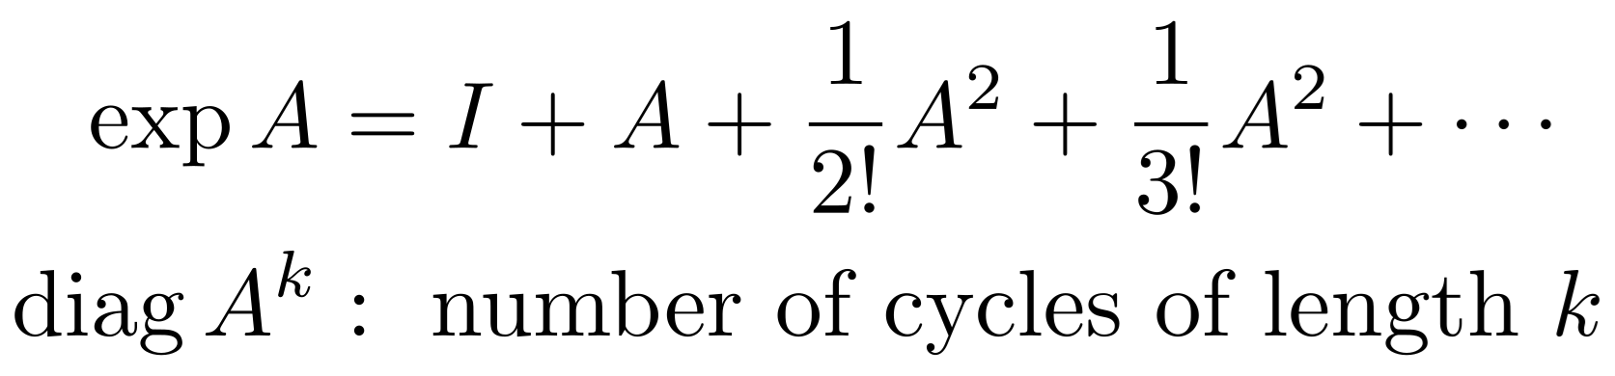
NOTEARS
Find a matrix W such that WX≈X and the corresponding graph is acyclic.
The acyclicity condition can be written trace exp |W| = n (where |·| is the elementwise absolute value)

Slide 60
LLM

Slide 61
LLM
Ask an LLM to give the causal graph, from metadata alone (column names + descriptions)
Ask an LLM to scour the literature to extract causal relations, and put them in a database (knowledge graph).
Efficient Causal Graph Discovery Using Large Language Models (T. Jiralerspong et al., 2024)

Slide 62
LLM
Ask an LLM to give the causal graph, from metadata alone (column names + descriptions)
Ask an LLM to scour the literature to extract causal relations, and put them in a database (knowledge graph).

Slide 63
Code

Slide 64
gCastle
import castle.algorithms
import networkx as nx
model = castle.algorithms.PC()
model.learn(X)
A = model.causal_matrix
A = pd.DataFrame( A, columns = X.columns, index = X.columns )
g = nx.from_pandas_adjacency( A, create_using = nx.DiGraph )

Slide 65
causal-learn
from causallearn.search.ConstraintBased.PC import pc from causallearn.utils.cit import fisherz, kci, chisq, gsq
# Computation g = pc(X.values)
# Extract the adjacency matrix A = pd.DataFrame( g.G.graph ) A = ( A == -1 ).astype(int) A.columns = A.index = X.columns.copy()

Slide 66
causal-learn
from causallearn.search.ScoreBased.GES import ges
r = ges(X.values)
A = pd.DataFrame( r['G'].graph )
A = ( A == -1 ).astype(int)
A.columns = A.index = X.columns.copy()

Slide 67
causal-learn
from causallearn.search.FCMBased.lingam import ICALiNGAM
model = ICALiNGAM()
model.fit(X)
A = model.adjacency_matrix_
A = pd.DataFrame( A != 0, index = X.columns, columns = X.columns )

Slide 68
cdt
import cdt # Causal discovery toolbox
import networkx as nx
pc = cdt.causality.graph.PC() # Continuous, Gaussian variables
g = pc.predict(d)
A = nx.adjacency_matrix(g).todense()
A = pd.DataFrame( X, index = g.nodes, columns = g.nodes )

Slide 69
dowhy
from dowhy import CausalModel
model = CausalModel(
data = X,
treatment = "T",
outcome = "Y",
graph = ' '.join( nx.generate_gml(g) ),
)
estimand = model.identify_effect()
estimate = model.estimate_effect(
estimand,
method_name = "backdoor.linear_regression",
)
model.refute_estimate(
estimand, estimate,
method_name = "random_common_cause",
)
estimate.interpret()

Slide 70
Examples

Slide 71
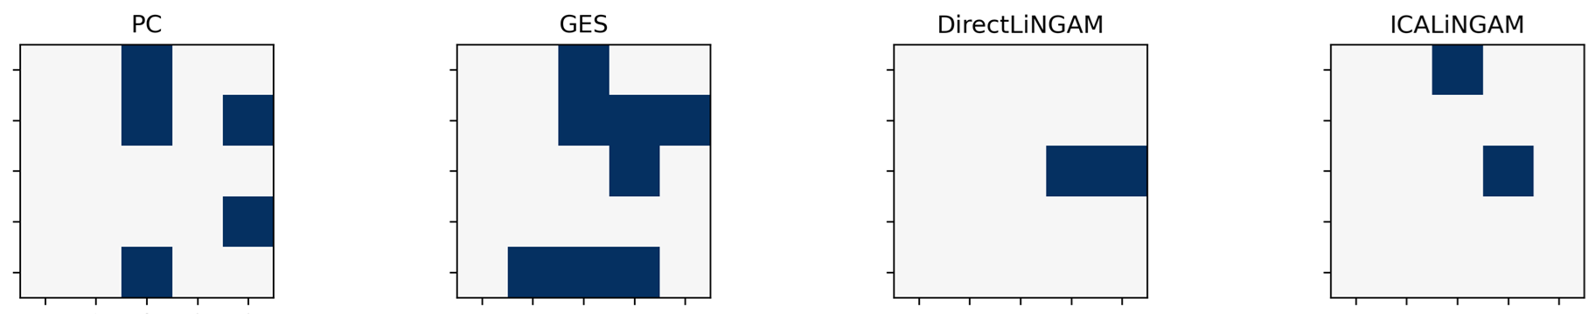
Examples
Different algorithms give very different results

Slide 72
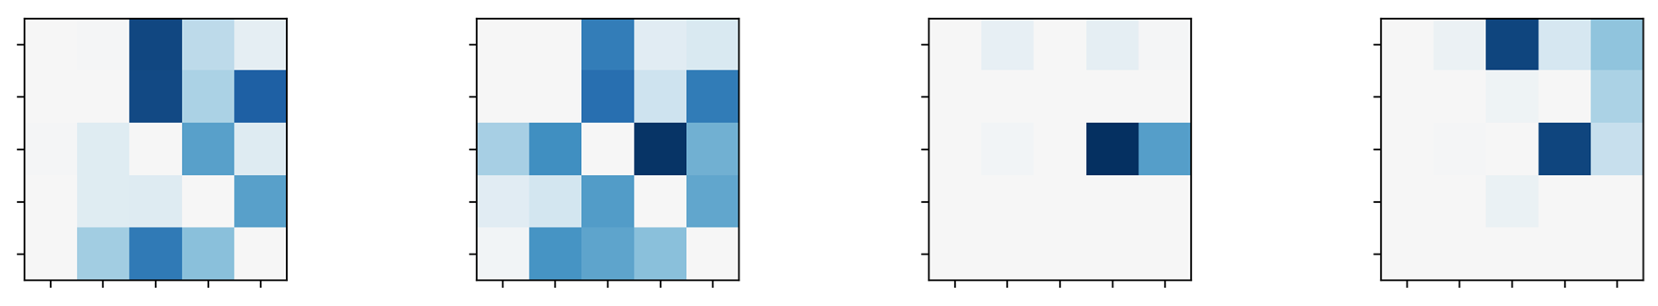
Examples
Different bootstrap samples give very different results

Slide 73
Conclusion

Slide 74
Summary
PC: conditional independence test
GES: goodness-of-fit of models predicting y from its parents
LiNGAM: independent component analysis
NOTEARS: optimization problem, with acyclicity constraint
Software: gCastle, causal-learn, cdt

Slide 75
Conclusion
Do not start from data, but from a domain knowledge causal graph
Do not use a single causal discovery algorithm, but several
Do not run them on just the data, but also on bootstrap samples
Do not only look at the output, look at the ingredients of the algorithms

Slide 76

Causality competition

Slide 77
References
Introduction to Causal Inference (B. Neal, 2020) A survey on causal discovery: theory and practice (A. Zanga and F. Stella, 2023) https://github.com/huawei-noah/trustworthyAI/tree/master/gcastle https://causal-learn.readthedocs.io/en/latest/ https://cran.r-project.org/web/views/CausalInference.html#dag

Slide 78
Extra Slides

Slide 79
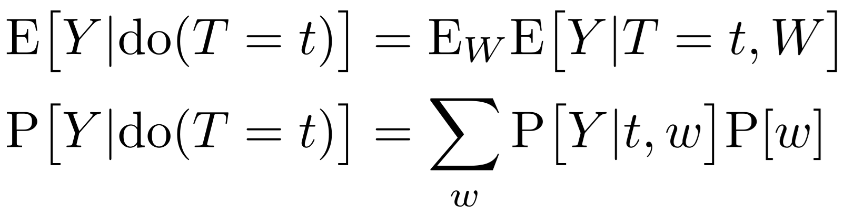
Backdoor adjustment
W
With linear models: fit a regression
Y = α + β T + γ W
and average W out:
Y = α + β T + γ E[W]
T
Y

Slide 80
Kernel methods
Many machine learning algorithms do not really require coordinates, but just the Gram matrix κᵢⱼ=⟨xᵢ,xⱼ⟩.
Increasing the dimension, κᵢⱼ=⟨ϕ (xᵢ), ϕ(xᵢ)⟩ does not change the size of the Gram matrix.
We do not even need to compute ϕ (xᵢ): we just need a (positive definite) kernel, κ(x,y)=⟨ϕ (x), ϕ(y)⟩.

Slide 81
Local BIC score of X→y
H = log( Σ[y,y] - Σ[y,X] Σ[X,X]⁻¹ Σ[X,y] )
-BIC = n·H + λ·k·log(n)
n = number of observations k = number of variables in X Σ = variance matrix of the data

Slide 82
Markov equivalence class
A CPDAG (complete partially directed acyclic graph) is a PDAG where
All undirected edges are reversible (you can choose either direction, that does not change the MEC)
All directed edges are compelled (if you flip them, the graph moves to another MEC)

Slide 83
Unused Slides

Slide 84
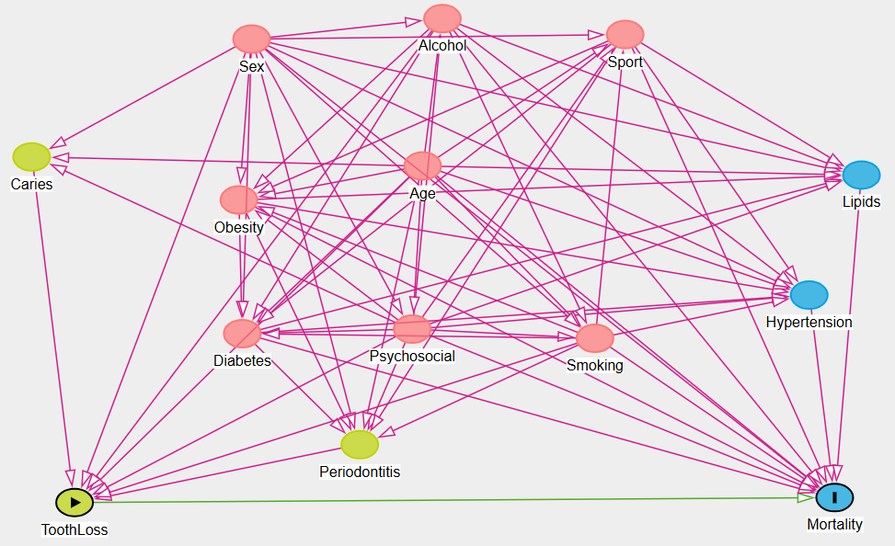
Real-world causal graphs
https://www.dagitty.net/dags.html

Slide 85
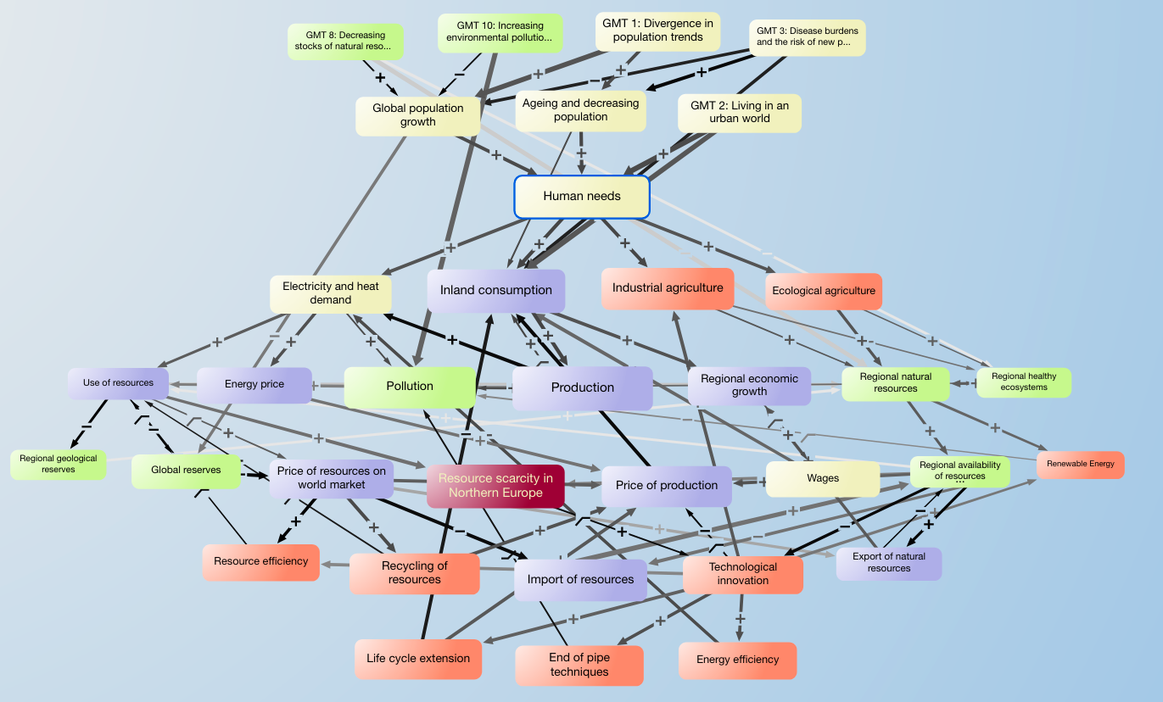
Real-world causal graphs
Impact assessment of global megatrends (U. Lorenz and H.V. Haraldson, 2014)

Slide 86
Real-world causal graphs
https://arxiv.org/abs/1906.01732

Slide 87
Variants of those algorithms
FCI: PC variant, allowing for unobserved confounders
FGES: faster implementation of GES
ARGES: another GES variant, for high-dimensional data
GFCI: GES variant allowing for unobserved confounders (FCI on the FGES skeleton)
CCD: PC/FCI with feedback (cycles)
LiNG: LiNGAM with feedback
Other LiNGAM variants: non-linear, post-non-linear
CD-NOD

Slide 88
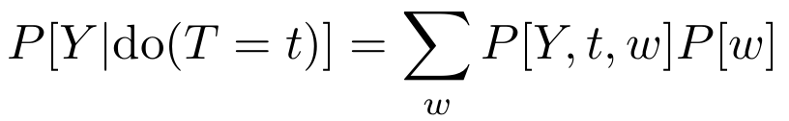
Back-door adjustment
W
T
Y

Slide 89
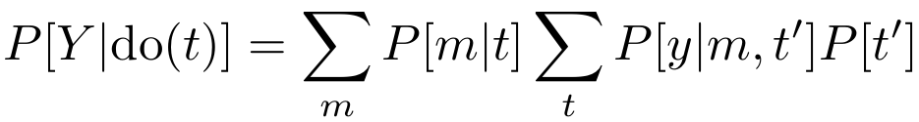
Front-door adjustment
W
T
M
Y

Slide 90
Causal inference
The sufficient conditioning set is not unique.
The parents of X form a sufficient conditioning set, but it may be needlessly large.
More generally, a sufficient conditioning set is a set of nodes blocking all the non-causal paths from X to Y, and leaving all the causal paths open.
If some variables are not observed, things get more complicated, but do-calculus can tell you if the effect can be estimated from observational data alone.

Slide 91
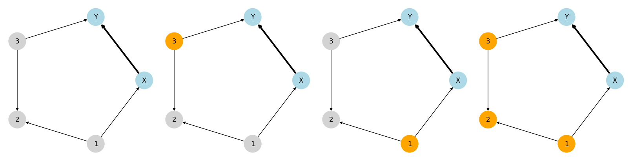
Sufficient Conditioning Sets

Slide 92
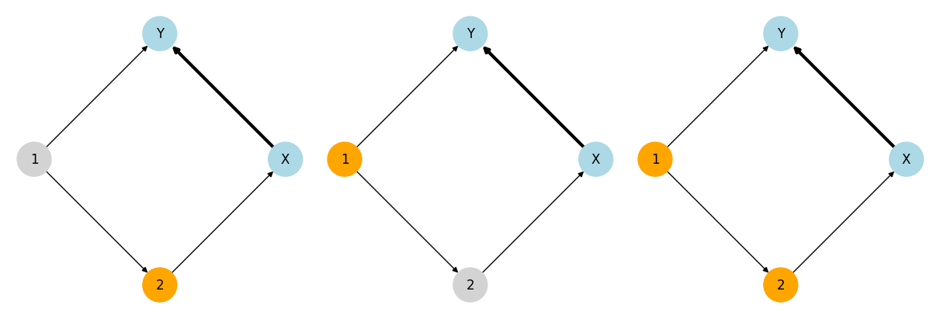
Sufficient Conditioning Sets

Slide 93
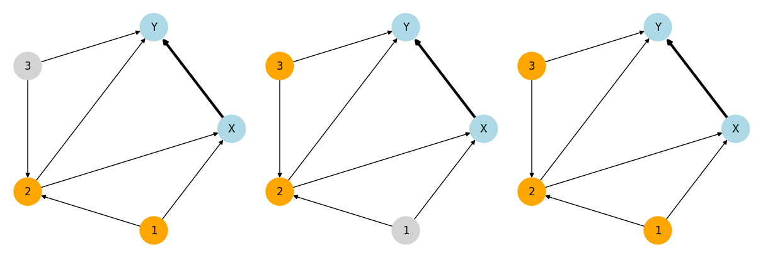
Sufficient Conditioning Sets

Slide 94
X
Y

Slide 95
Relation of interest
X
Y

Slide 96
Confounder
X
Y

Slide 97
Collider
X
Y

Slide 98
Mediator
X
Y

Slide 99
Independent
X
Y

Slide 100
Cause of X
X
Y

Slide 101
Consequence of X
X
Y

Slide 102
Cause of Y
X
Y

Slide 103
Consequence of Y
X
Y

